Slide 1
Lloyd McKenzie – Gevity Consulting
Exchanging FHIR Data – Choosing the right approach

Slide 2

Who am I?
Name: Lloyd McKenzie
Company: Gevity
Background:
One of FHIR’s 3 initial editors
Co-chair FMG & FHIR Infrastructure
Heavily involved in HL7 and healthcare exchange for last 20 years
v2, v3, CDA, etc.
Technical lead for Da Vinci Health Record Exchange (HRex)
lmckenzie@gevityinc.com

Slide 3
Learning Objectives
What are the FHIR exchange options?
What are the considerations in choosing between the options?
Notes:
When writing learning objectives, we suggest that the initial word of each learning objective be a verb as shown on the http://ccc.clinton.edu/CurriculumCommittee/ListofMeasurableVerbs.cxml web page. Please ensure your learning objectives are located at multiple/different 'levels' (see https://teaching.uncc.edu/services-programs/teaching-guides/course-design/blooms-educational-objectives for additional details).

Slide 4


Creative Commons - Attribution
Download, use as you wish, just thank HL7 (and maybe me)
You might also enjoy “Flicker or Bonfire” – my architecture presentation from last year

Slide 5

Context for this presentation
20+ Implementation Guides
Different approaches
Questions about why approach chosen
Needed a better answer than “because that’s what we decided”
Undertook a deep analysis of what the options were and what should be used when

Slide 6
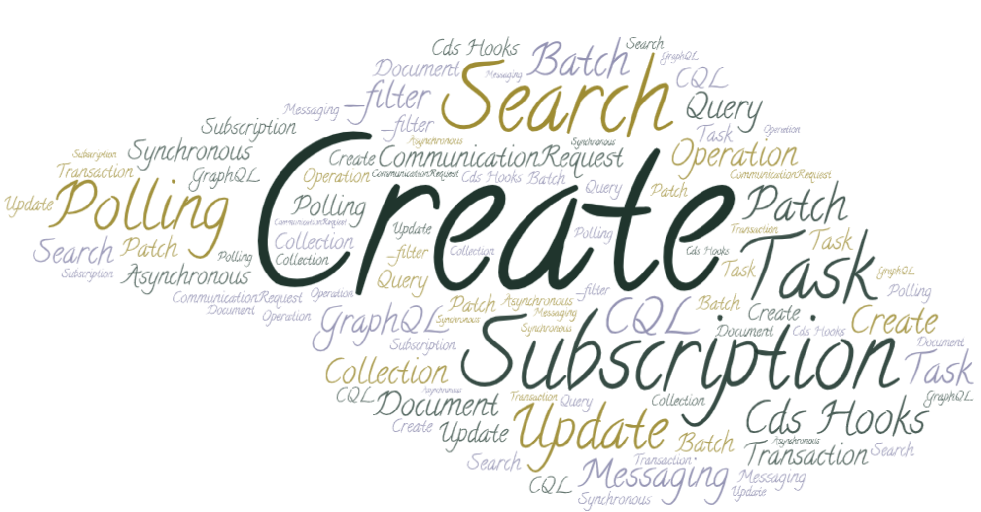
FHIR defines a LOT of ways to share data
21 in total
Or more…
Notes:
Asynch vs. synchronous
Workflow approaches for Task/CommunicationRequest
Only those defined by HL7 international (so not SQL-on-FHIR)

Slide 7
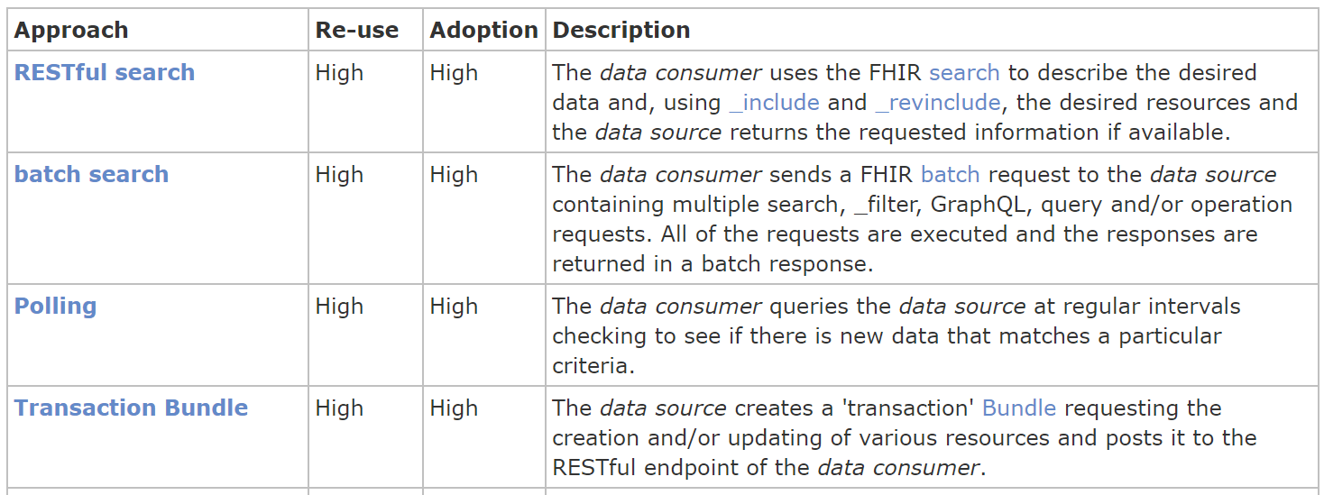
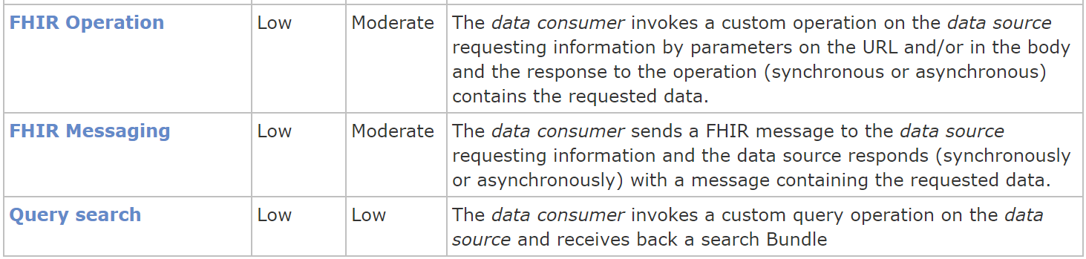
So – how to choose?
How re-useable / multi-purpose?
How widely adopted?
…

Slide 8
Re-useable/multi-purpose
REST Encounter update
Revise info as part of pre-admit message
Capture “patient arrival”
Transfer patient
Schedule for discharge
Correct “reason for admission”
Capture end time of patient phone-call
Etc.
V2 ADT A01 message
Patient has been admitted

Slide 9
How widely adopted?
Often equivalent to “how easy to adopt?”
Do it all or do part?
Ease of layering over legacy
E.g. REST search vs. _filter

Slide 10
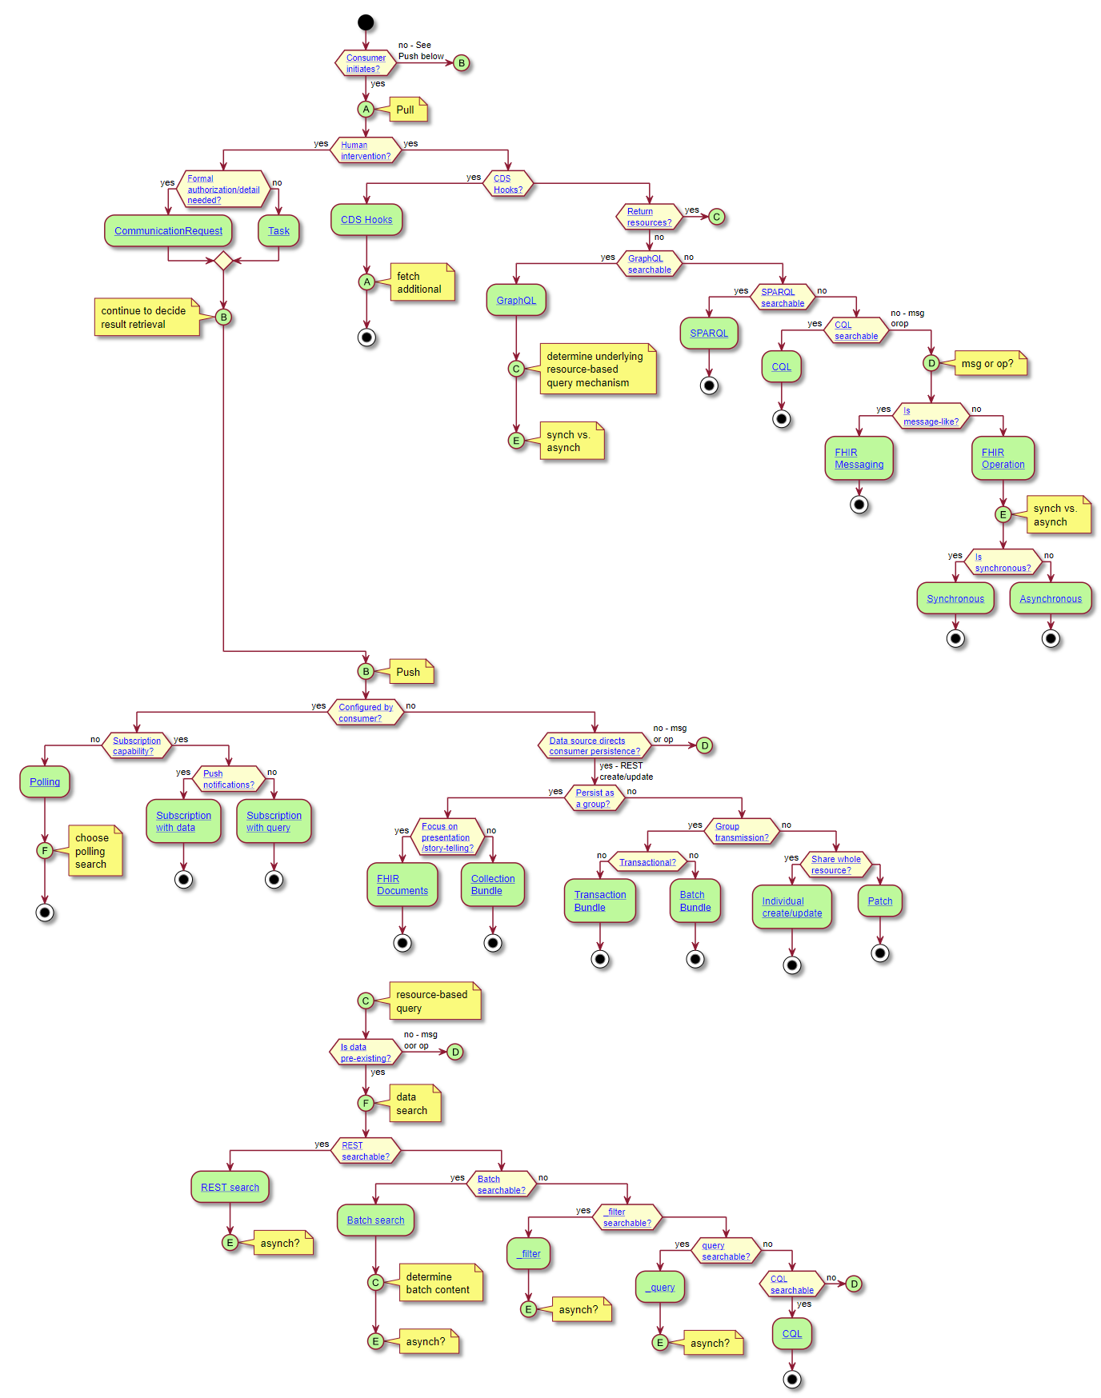
How to choose
What’s your use-case?
https://build.fhir.org/ig/HL7/davinci-ehrx/exchanging.html

Slide 11
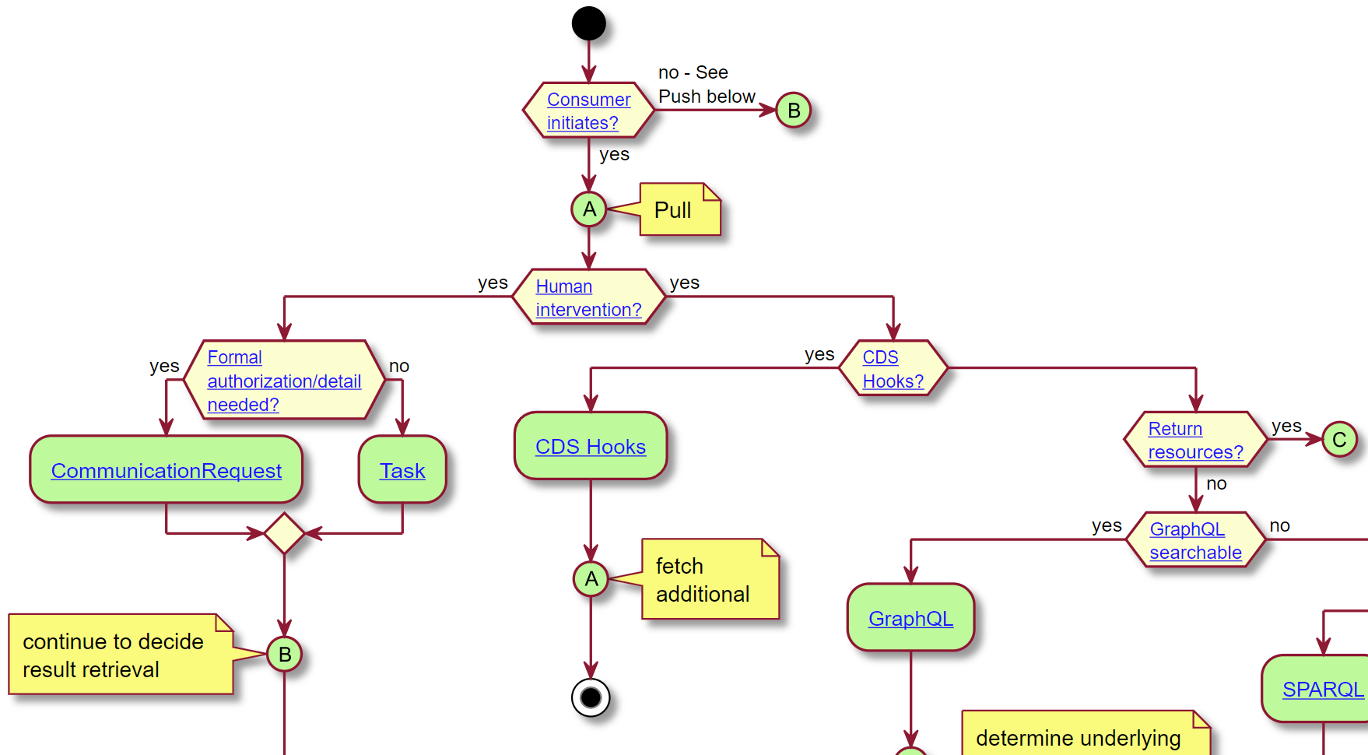

Slide 12
Some caveats
Informative, not normative
Other factors will matter
Legacy capabilities
Existing infrastructure
Internal architecture conventions
Personal preference
What do your partners support?

Slide 13
What are the options?
Pull resources
Read, search, batch search, vread, history, _filter, _query, CQL, Task, CommunicationRequest, operations, messaging
Pull data elements
CDS Hooks, GraphQL, SPARQL, CQL, operations, messaging
Consumer-directed push
Polling, subscription – notification, subscription w/ data
Source-directed push
REST create/update, batch, transaction, patch, document, collection, Operation, Message

Slide 14
Key decision points
Pull vs. push
Are humans involved?
Are you retrieving resources or data elements?
Is push ‘consumer-configured’?
Does source direct persistence?
Does data already exist?
Store as a collection or individually?
Synchronous or asynchronous?
Notes:
Polling is still ‘push’

Slide 15
Where is this work going?
Reviewed and discussed by various work groups
Found in Sept 2020 ballot release of Davinci HRex IG
Publication target Q1 2021
All Da Vinci IGs will reference
Will also explain tree navigation rationale
Encourage other IGs to do the same
Will migrate into FHIR R5 when it comes out
Work in progress will be here:
https://build.fhir.org/ig/HL7/davinci-ehrx/exchanging.html

Slide 16
Summary
Many options to share data
Some widely adopted (easier)
Some provide greater re-useability
Standard guidelines to help choose
Greater consistency in choices = more interoperability

Slide 17



Contact
During DevDays, you can find / reach me here:
Via Whova App – Speaker’s Gallery
Email: lmckenzie@gevityinc.com
Or, better yet, include the community and ask/discuss on http://chat.fhir.org

